Slide 1
Exploratory Data Analysis of IT Company Layoffs (2022–2023)
- K SHRUTI SURESH BABU
Data Science Intern

Slide 2
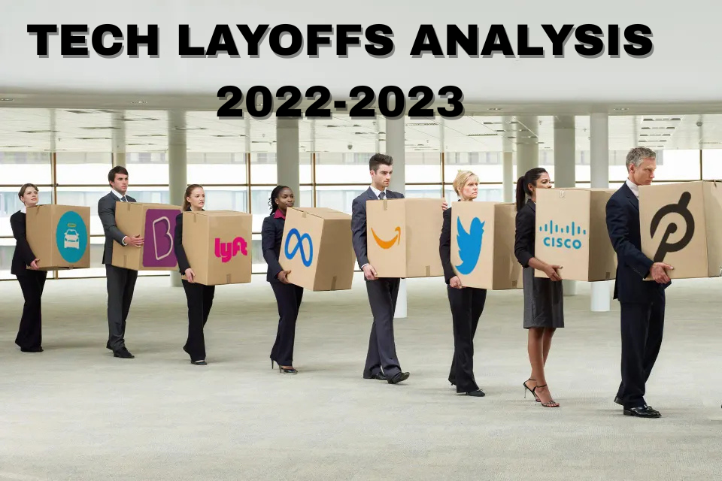

Slide 3
ABSTRACT
This project uses Exploratory Data Analysis (EDA) to study technology company layoffs during 2022–2023. After data cleaning, industry-wise and time-based analyses were performed to identify the most affected sectors and layoff trends in relation to global economic changes. The study provides a data-driven view of the “Efficiency Year” in the tech industry.

Slide 4
INTRODUCTION
In the wake of the COVID-19 pandemic, the technology sector experienced unprecedented growth, leading to aggressive "over-hiring" as companies prepared for a permanently digital world.
However, by late 2022, shifting economic conditions including rising inflation and interest rates forced a massive market correction.
This period saw the largest workforce reductions in the history of modern tech, affecting giants like Google, Amazon, and Meta, as well as thousands of startups.
The data used for this project was sourced from Kaggle, the premier platform for data science research.
The original records were aggregated by Layoffs.fyi, a world renowned real time tracker founded by entrepreneur Roger Lee
The dataset captures factual, real-world events from 2022 to 2023, including company names, the number of layoffs, and the percentage of the workforce impacted, providing a high-fidelity record for Exploratory Data Analysis (EDA).

Slide 5
PROBLEM STATEMENT
During the COVID-19 pandemic (2020-2021), tech companies saw a massive boom in demand as the world moved online.
Believing this growth would last forever, they over-hired aggressively. However, in 2022 and 2023, the economic climate shifted due to rising inflation and higher interest rates.
This forced companies to shift their focus from 'growth at all costs' to 'efficiency,' leading to a massive market correction and the widespread layoffs captured in this dataset.“
The problem is to understand which companies, industries, and locations were most affected, and to analyze layoff trends across 2022 and 2023.

Slide 6
PROPOSED SOLUTIONS
Stage 1: Data Engineering (Python)
Data Preservation: Created a raw_df copy to maintain data integrity throughout the process.
Noise Reduction: Dropped non-analytical columns like sources and additional_notes to improve processing speed and focus.
Type Conversion: Used pd.to_datetime and pd.to_numeric with errors='coerce’.
This is a critical step to handle the "dirty data" (text mixed with numbers) often found in real-world Kaggle datasets.
Feature Engineering: Deconstructed the reported_date column into Year, Month, and Day to allow for time-series analysis.

Slide 7
Stage 2: Statistical Aggregation & Analysis
Grouped Analysis: Multi-level grouping by Company, Industry, Location to calculate total impact.
Data Persistence: Exported cleaned dataset to .xlsx for Tableau integration.
Stage 3: Business Intelligence (Tableau)
Visual Discovery: Created interactive dashboards & python visualization to compare industries, companies, and regions for 2022–2023 layoffs.

Slide 8
OBJECTIVES
Analyze overall layoff trends in the tech industry during 2022–2023.
Identify the most affected companies in terms of total layoffs.
Determine which industries within tech were hit hardest.
Examine geographical patterns, highlighting regions or headquarters most impacted.
Compare layoffs between 2022 and 2023 to understand how trends changed over time.
Visualize key insights using Python (EDA),Python Visualization and Tableau dashboards for better interpretation.

Slide 9
DATASET DESIGN
Raw Dataset : Contains unprocessed and inconsistent values
COLUMN NAME | DESCRIPTION
company | Name of the technology company
total_layoffs | Number of employees laid off
impacted_workforce_percentage | The share of a company’s total employees impacted by layoffs.”
reported_date | Date when layoff was reported
industry | Industry sector of company
headquarter_location | Location of company headquarter
status | whether a company is publicly traded or privately owned.
sources | Source link of layoff information
additional_notes Extra remarks related to the layoff

Slide 10
Dropped Columns Are:
sources
additional_notes
Reason
Not required for exploratory analysis
Do not contribute to numerical or categorical insights
Data Cleaning
Converted total_layoffs and impacted_workforce_percentage to numeric
Handled missing and invalid values
Preserved original data using raw_df
Date attributes (Year, Month, Day, month_name) were extracted from reported_date for time-based analysis

Slide 11
Cleaned Dataset : Used for EDA and Visualizations
COLUMN NAME | DESCRIPTION
company | Name of the technology company
total_layoffs | Number of employees in object format
impacted_workforce_percentage | The share of a company’s total employees in object format
reported_date | Date when layoff was reported
industry | Industry sector of company
headquarter_location | Location of company headquater
status | Current status of company
Year | Extracted for time based analysis
Month | Extracted from date
Day | Extracted from date
month_name | Extracted from date
total_layoffs_numeric | Contains numeic values
workforce_percentage_numeric | Contains numeric values

Slide 12
ALGORITHM
Start
Data Ingestion: Load the raw CSV file from Kaggle using Pandas.
Data Preservation: Create a copy for data safety.
Data Preprocessing :Drop non-essential columns (sources, notes).
Type Conversion (Numeric Coercion): Convert total_layoffs impacted_workforce_percentage to Numeric (Float/Int).
Date Conversion: Convert reported_date to DateTime format.
Feature Engineering: Extract Year, Month, and Day from the date objects.
Data Cleaning: Remove rows with null values in target columns to prevent skewed results.
Aggregation: Group data by Industry, Company, and Location using .sum().
Export: Save the cleaned dataframe to Excel for Business Intelligence visualization.
End

Slide 13
BLOCK DIAGRAM
Raw Dataset (CSV – Kaggle)
Data Loading (Pandas)
Data Preservation (raw_df)
Preprocessing
(Drop irrelevant columns)
Aggregation (Company / Industry / Location)
Data Cleaning (Remove null values)
Feature Engineering (Year, Month, Day)
Type Conversion (Numeric & DateTime)
Cleaned Dataset
BI Visualization (Tableau)

Slide 14
SOFTWARE & HARDWARE USED
Software: Windows 11, Jupyter Notebook, Tableau Public.
Hardware: Intel i5 Processor,

Slide 15
TOOLS & TECHNOLOGIES
Python (Pandas)
Used for data manipulation, preprocessing, and cleaning operations such as filtering, type conversion, and feature engineering.
Python (NumPy)
Used for numerical computations and efficient handling of missing (NaN) values.
Tableau
Used for advanced data visualization, aggregation, and creation of interactive dashboards and stories.
OpenPyXL
Used to enable seamless interaction between Python and Excel for exporting cleaned datasets.

Slide 16
WORKFLOW
Data Collection
  Sourced the Technology Company Layoffs dataset from Kaggle.
Data Transformation
  Converted text-based layoff and workforce percentage fields into numeric format.
  Processed date fields and derived time-based features.
Data Exploration
  Performed exploratory data analysis by grouping and aggregating data by industry, company, and location to identify the hardest-hit sectors.
Reporting & Visualization
  Created visual insights and dashboards using Tableau and python visualization libraries to support analytical findings.

Slide 17
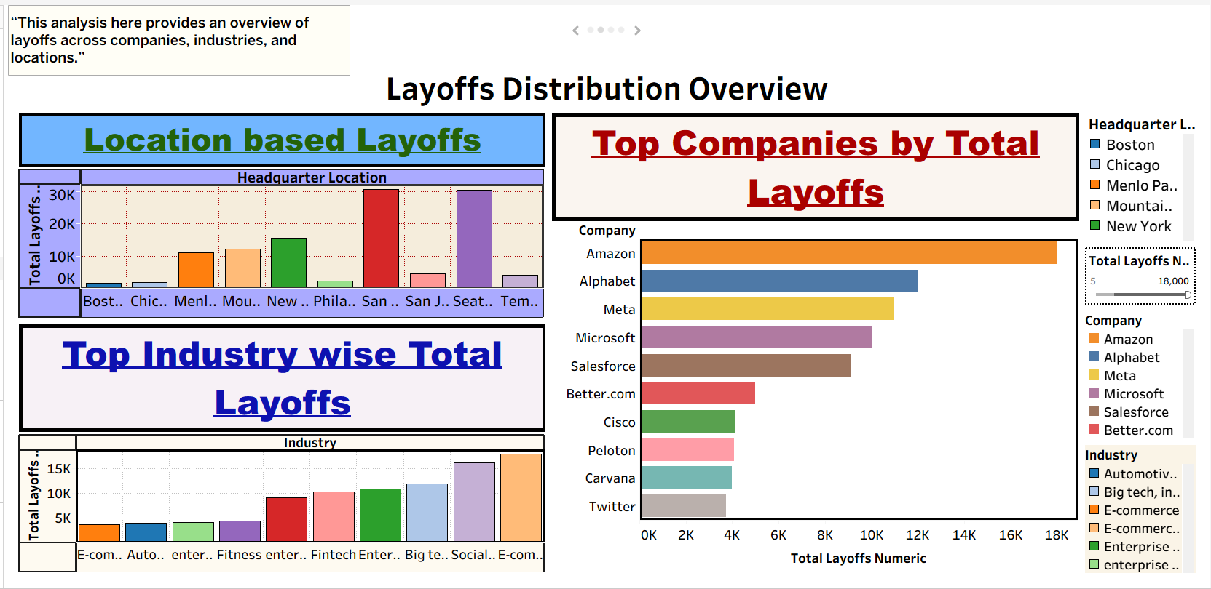
Results & Visualization Screenshots in Tableau

Slide 18
1. Top Companies by Total Layoffs
Findings:
Amazon leads with the highest number of layoffs (approximately 18K ), followed by Alphabet (Google), Meta, and Microsoft.
Analysis:
This indicates that the 2022–2023 market correction was primarily driven by large technology companies. These organizations expanded rapidly during the pandemic and later optimized their workforce as part of cost-restructuring and efficiency measures.
2. Top Industry-wise Total Layoffs
Findings:
The E-commerce industry shows the highest layoffs(18,000 approx), followed by Social Media and Big Tech/Big Data sectors.
Analysis:
This trend reflects a post-pandemic shift in consumer behavior, where demand moved back toward offline services. As a result, digital-first industries faced higher cost pressures, leading to workforce reductions.

Slide 19
3. Location-based Layoffs
Findings:
San Francisco (35,745 appro) and Seattle (35,477 approx.) report significantly higher layoffs compared to other locations.
Analysis:
This demonstrates the geographical concentration of layoffs in major technology hubs. Since these cities host headquarters of large tech firms, workforce reductions were more visible in these regions.

Slide 20
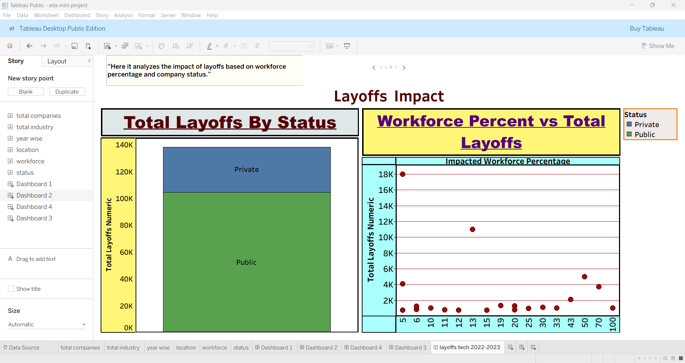

Slide 21
4. Total Layoffs by Company Status
Findings:
Public companies account for a larger share of total layoffs compared to private companies.
Private companies contribute a smaller, but still significant, portion of layoffs.
Analysis:
Public companies are more exposed to market pressure, shareholder expectations, and quarterly performance targets. As a result, they tend to implement workforce reductions more aggressively during economic slowdowns.
5. Workforce Percentage vs Total Layoffs
The scatter plot reveals that while some companies had massive layoff counts (18K), their impacted workforce percentage was relatively low (around 5%).
Companies with a small workforce percentage affected can still report high total layoffs.
Some companies show high workforce impact percentage but lower absolute layoff numbers.
Analysis:
This highlights the difference between absolute impact (total layoffs) and relative impact (percentage of workforce affected).
Large companies may lay off thousands of employees while affecting a small percentage, whereas smaller companies may lay off fewer employees but impact a larger portion of their workforce.

Slide 22
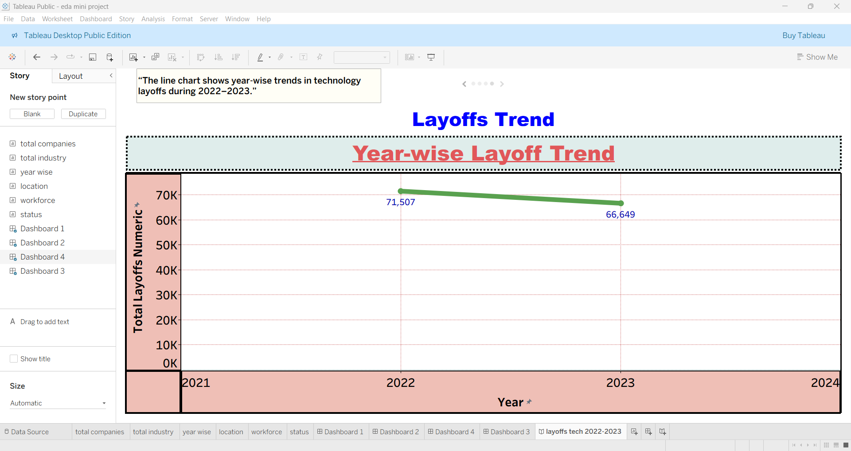

Slide 23
6. Layoffs Trend Analysis (2022–2023)
Findings
In 2022, total layoffs were approximately 71,507.
In 2023, total layoffs slightly decreased to around 66,649.
The trend shows a marginal decline in total layoffs from 2022 to 2023.
Analysis
The peak in 2022 reflects the initial correction phase following rapid hiring during the pandemic.
The slight decline in 2023 suggests that companies began stabilizing their workforce after major restructuring.
The year-wise trend shows that layoffs peaked in 2022 and slightly decreased in 2023, indicating post-pandemic workforce correction.

Slide 24
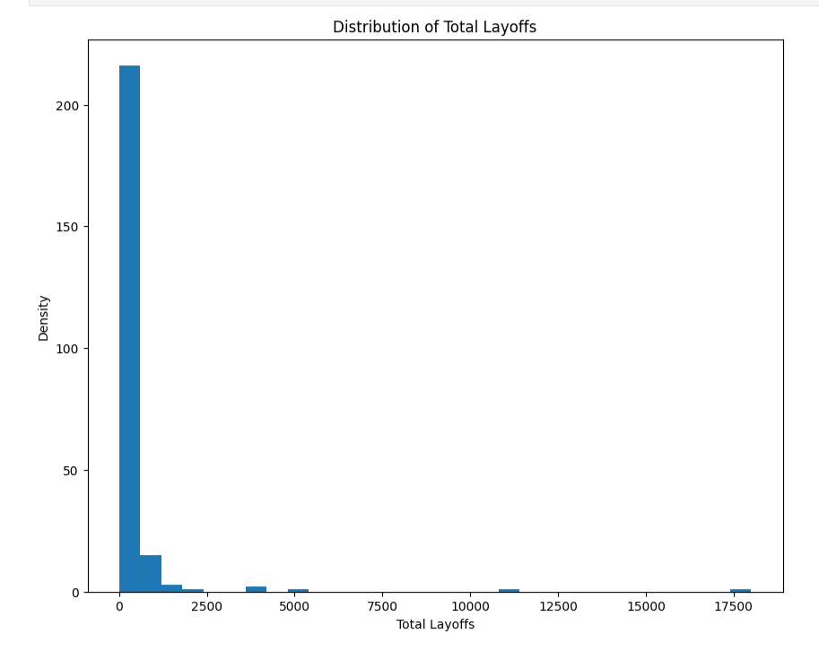
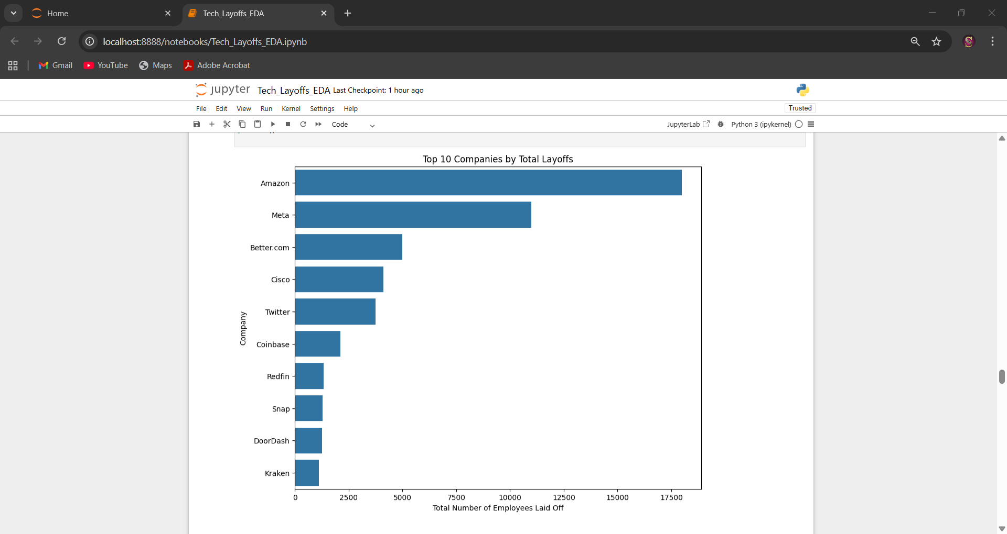
Results & Visualization Screenshots in PYTHON

Slide 25
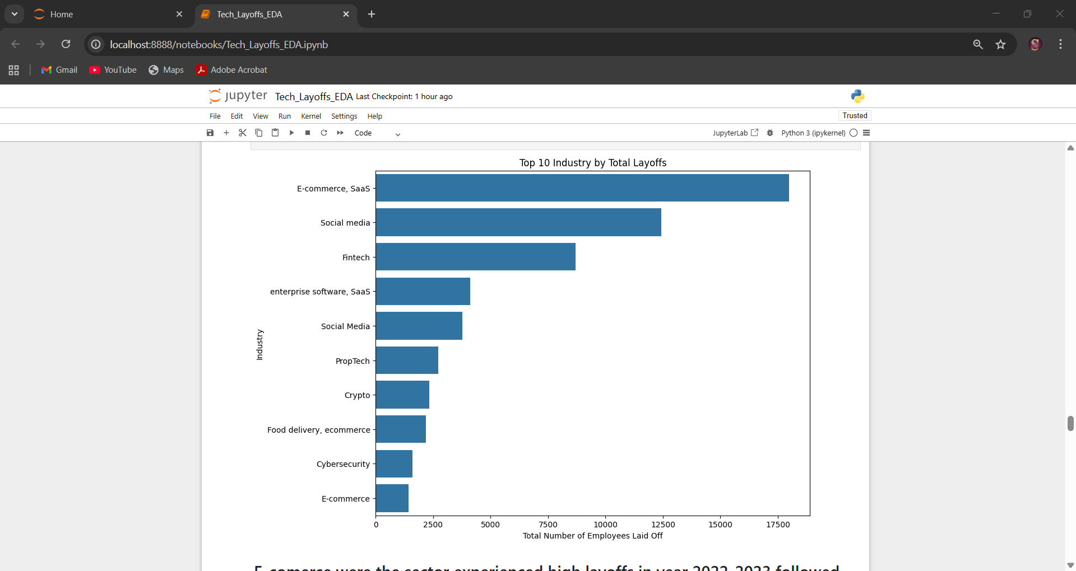
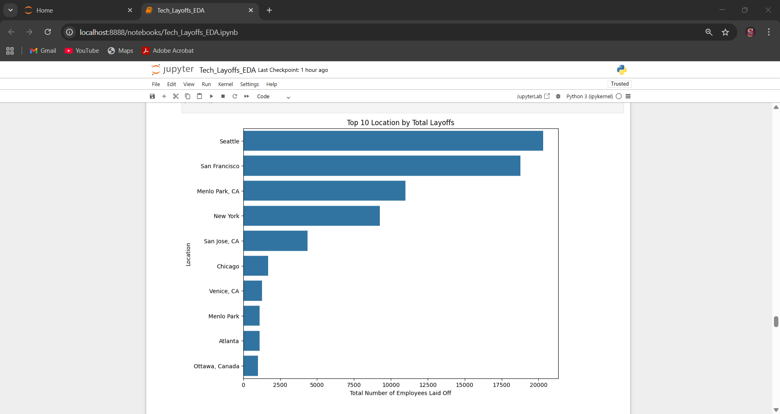

Slide 26
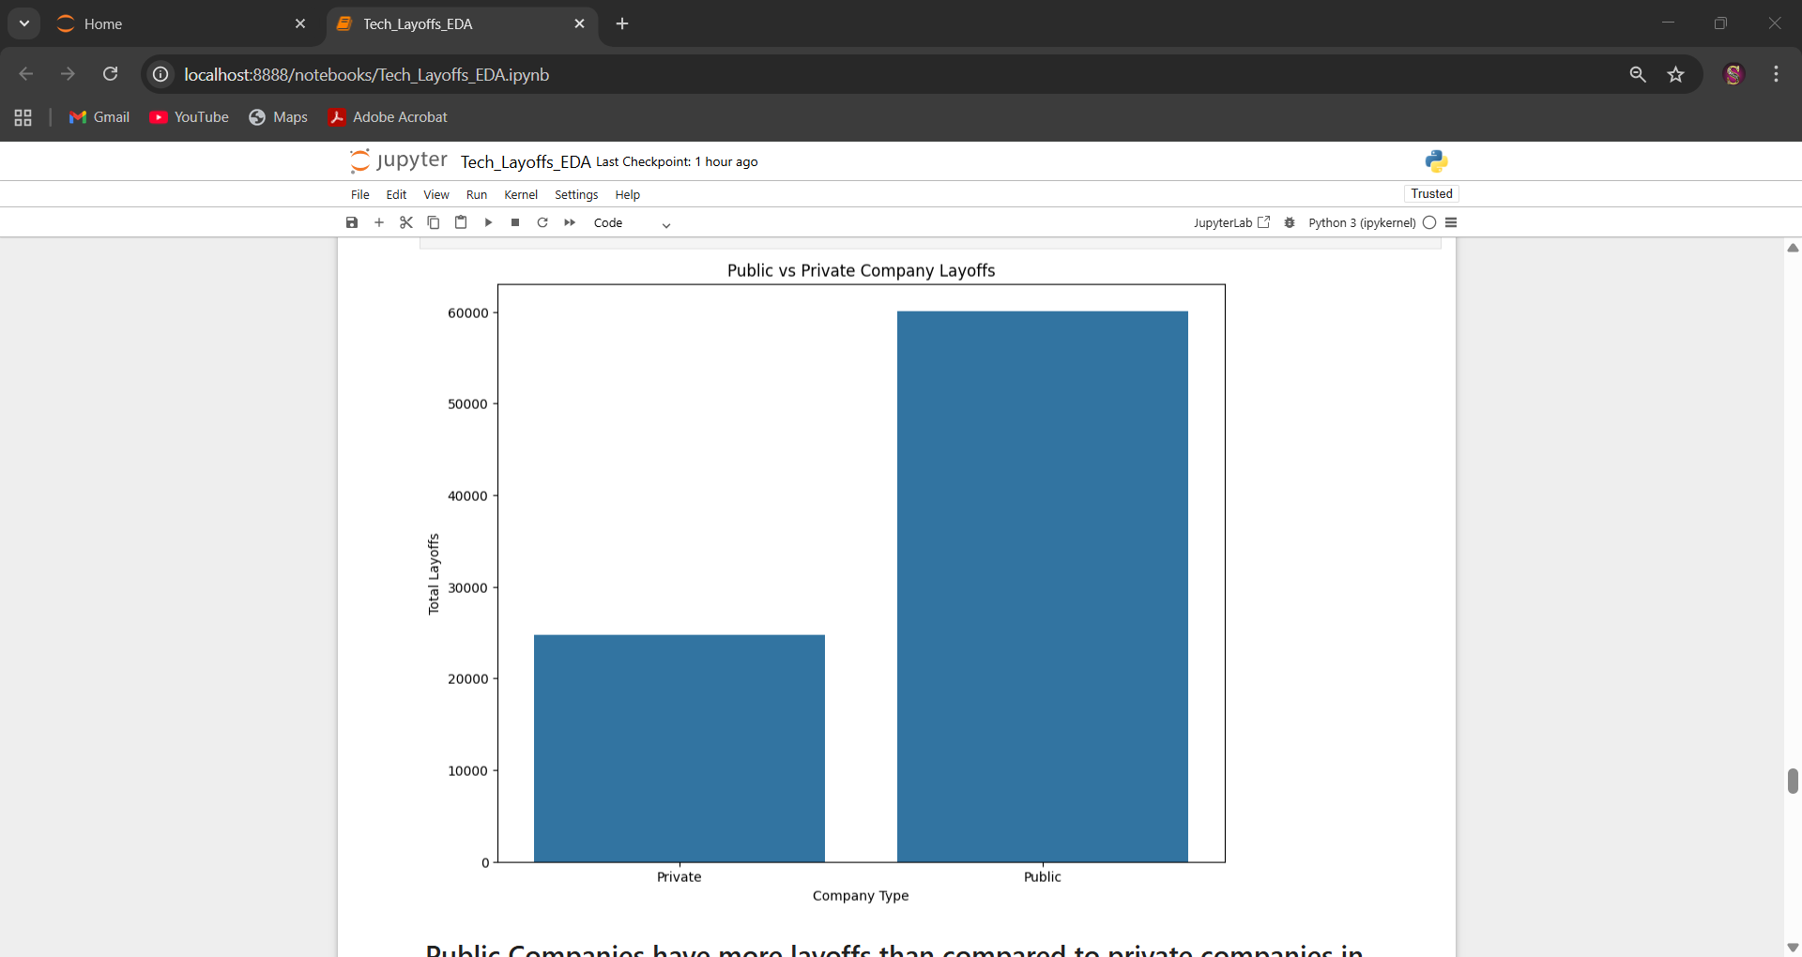
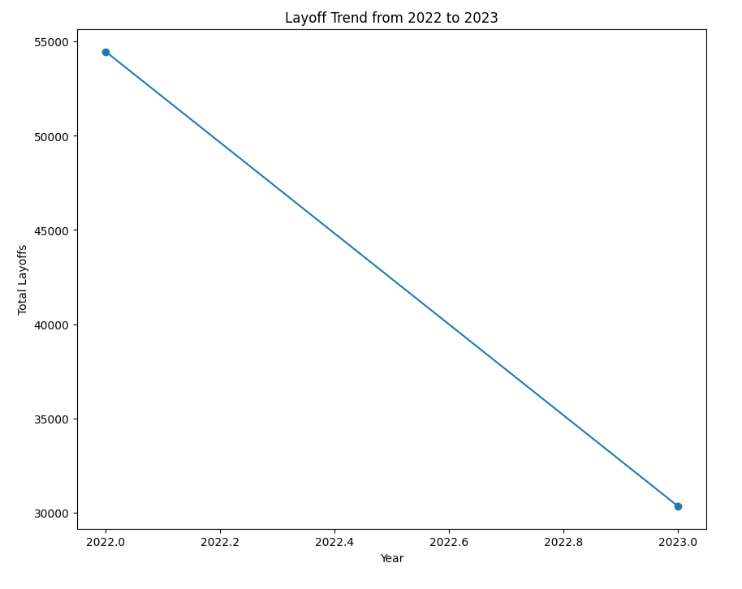

Slide 27
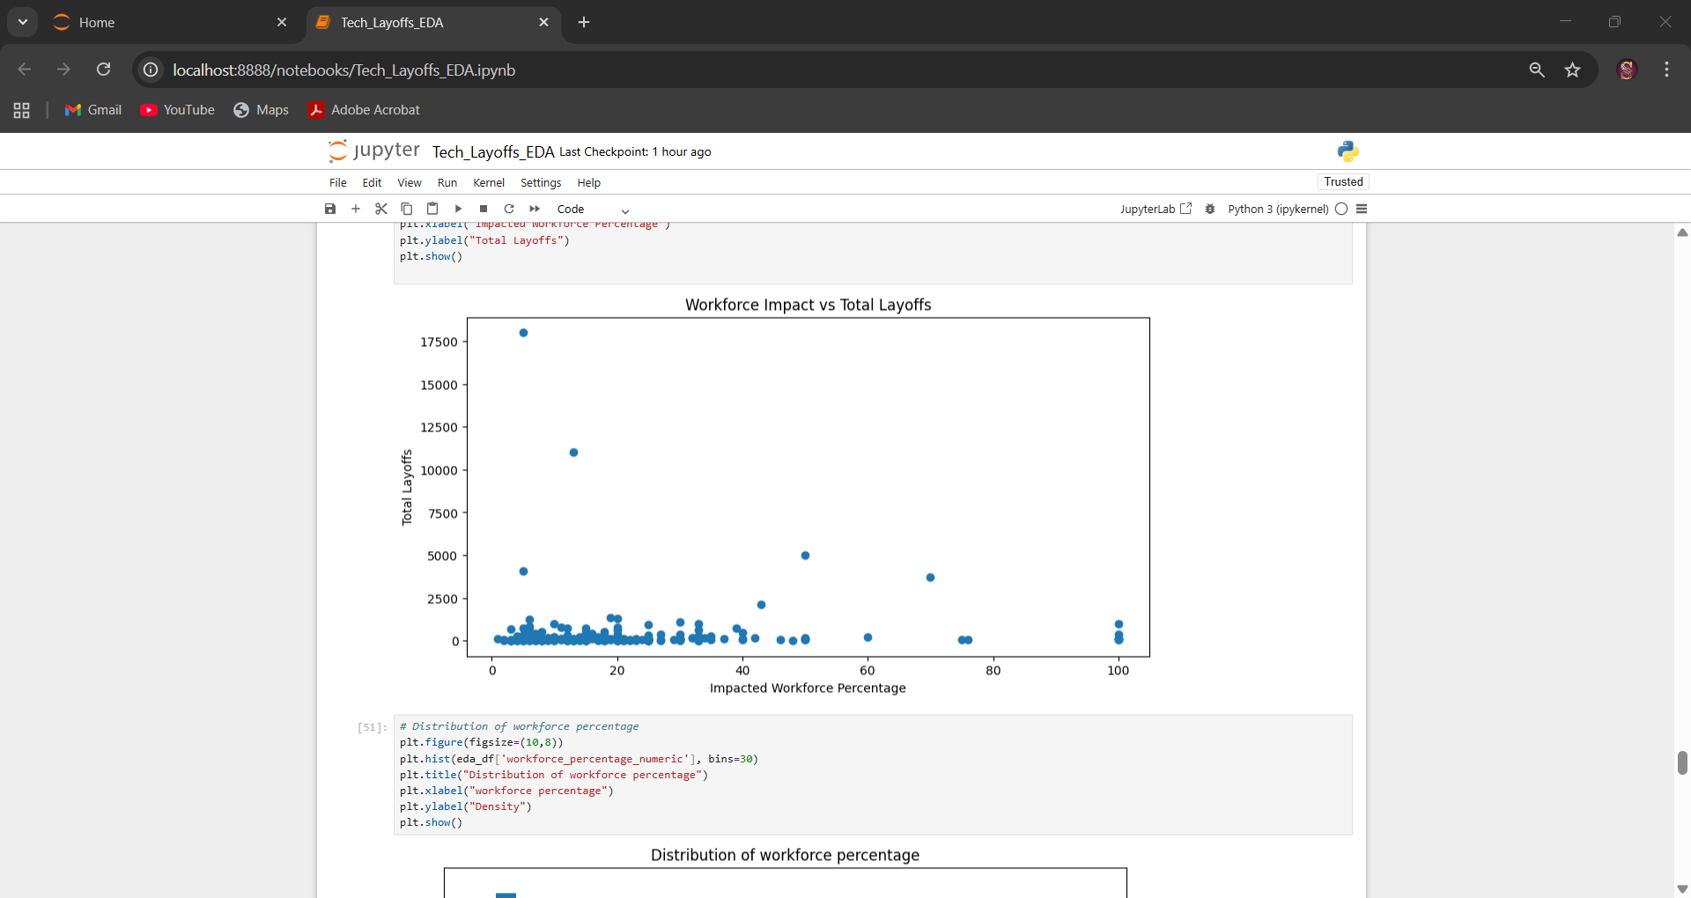
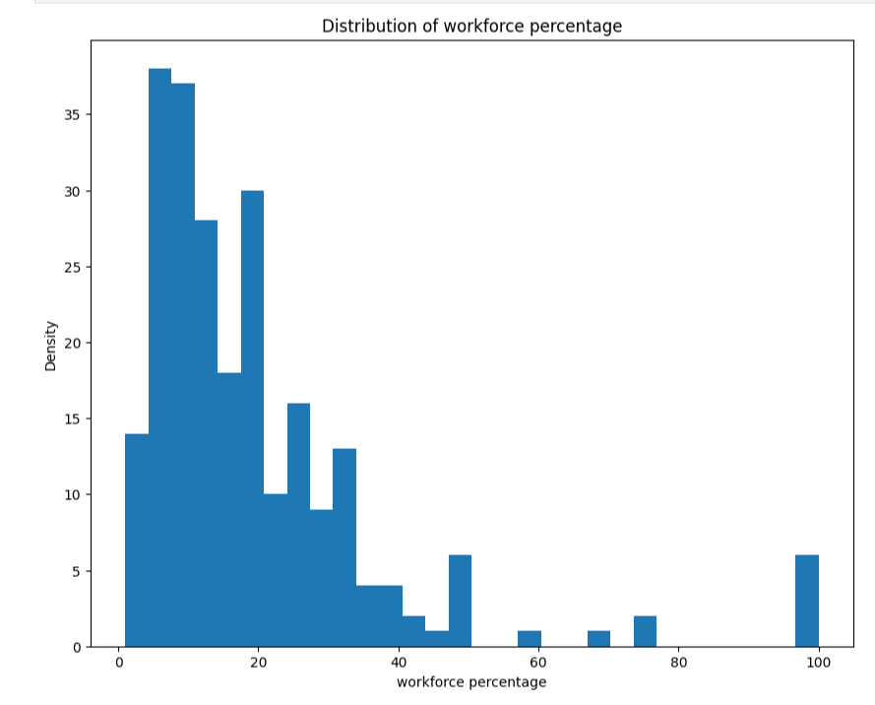

Slide 28
COMPANY – WISE TOTAL-LAYOFFS - BAR PLOT
INDUSTRY-WISE TOTAL LAYOFFS – BAR PLOT
LOCATION –WISE TOTAL LAYOFFS – BAR PLOT
WORKFORCE IMPACT vs LAYOFFS – SCATTERPLOT
PUBLIC vs PRIVATE - BAR PLOT
LAYOFFS TREND FROM 2022-2023 – LINE PLOT
DISTRIBUTION OF WORKFORCE ERCENTAGE – HISTOGRAM
Analysis : Very few companies have large layoffs (close to 7000)
DISTRIBUTION OF TOTAL LAYOFFS – HISTOGRAM
Analysis : most companies had a low workforce impact
These visualizations support and validate the insights obtained using Tableau.

Slide 29
CONCLUSIONS
Company Dominance: Amazon recorded the highest number of layoffs (≈18,000), followed by Alphabet, Meta, and Microsoft, indicating that large technology firms were the most affected
Industry Impact: The E-commerce sector experienced the highest layoffs, followed by Social Media, highlighting the vulnerability of digital-first industries.
Geographic Concentration: Layoffs were heavily concentrated in San Francisco and Seattle, major technology hubs hosting global tech headquarters.
Company Status Effect: Public companies accounted for a significantly higher volume of layoffs (over 100,000) compared to private companies, reflecting greater market and investor pressure.
Year-wise Trend: Layoffs peaked in 2022 (71,507) and showed a slight decline in 2023 (66,649), suggesting gradual workforce stabilization.

Slide 30
DIAGNOISIS
The primary cause of large-scale layoffs was over-hiring during the pandemic period, followed by a market slowdown.
Post-pandemic shifts in consumer behavior reduced demand for digital-first services, especially in E-commerce and Social Media.
Rising operational costs and pressure to improve profitability led companies to focus on workforce optimization and efficiency.
Public companies were more affected due to investor expectations and quarterly performance pressure.

Slide 31
FUTURE SCOPE
Apply predictive analytics or machine learning models to which companies might lay off next based on funding status.
Perform role-based and experience-level analysis to understand which job categories are most impacted.
Integrate real-time dashboards for continuous monitoring of workforce trends.
Sentiment Analysis: Scraping Twitter/X to see how employee morale changed during these layoff dates.

Slide 32
REFERENCES
Lee, R. (2024). Layoffs.fyi Dataset.
Kaggle.com: "Tech Layoffs 2022-2023" Repository.

